Slide 1

SQL - Structured Query Language
SQL is mainly used to store structured data (data in rows and columns)
SQL is used to manage data in databases
Used in banks, colleges, websites, and mobile applications
Helps to store, retrieve, update, and delete information easily
Chosen because it is simple, fast, reliable, and handles large data
Example :
Managing student details, bank accounts, and online
shopping data using SQL
Workflow

Slide 2
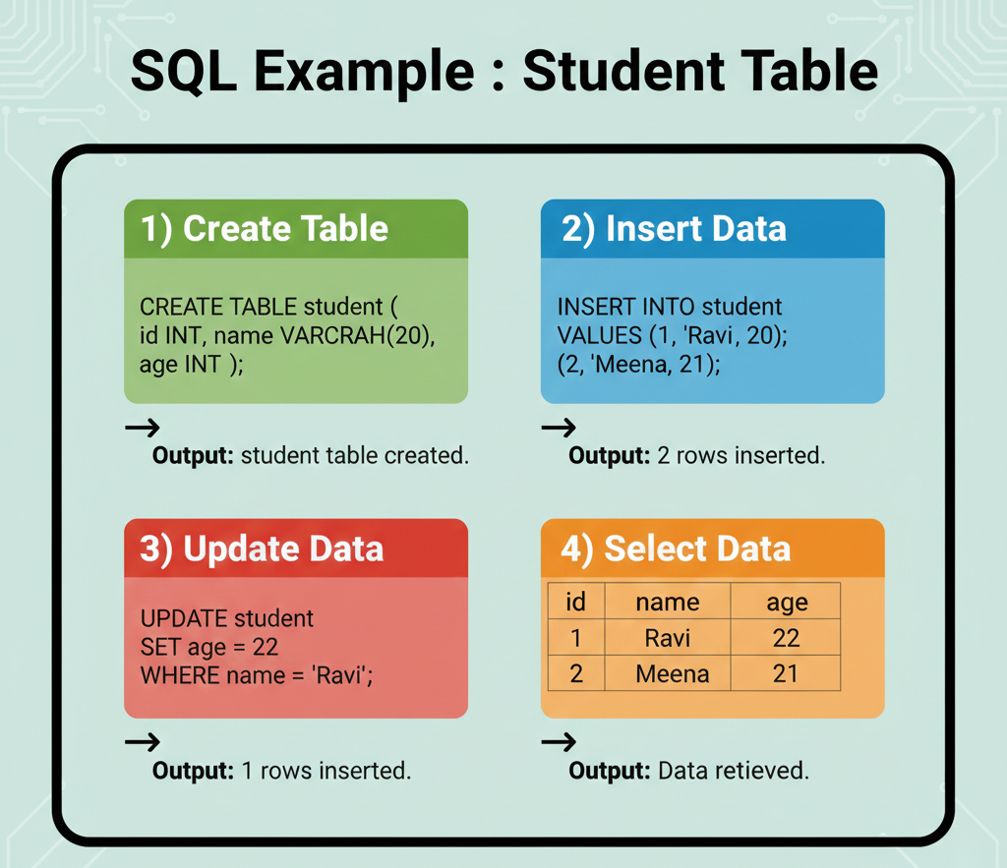
MySQL – Tool, Commands & output
Tool Used:
MySQL
Oracle Database
PostgreSQL
SQLite
Basic SQL Syntax :
SELECT * FROM table_name;
Basic Commands:
CREATE – create a table
INSERT – add data
UPDATE – change data
DELETE – remove data

